Slide 1
LOGIC BUILDING
HANDS-ON

Slide 2
Pattern Printing
Pattern printing is important for logic building in programming because it helps develop a strong understanding of loops, conditional statements, and nested structures. It enhances problem-solving skills by requiring logical thinking to break down complex problems into smaller steps. Additionally, it strengthens algorithmic thinking and improves the ability to visualize and implement solutions efficiently.

Slide 3
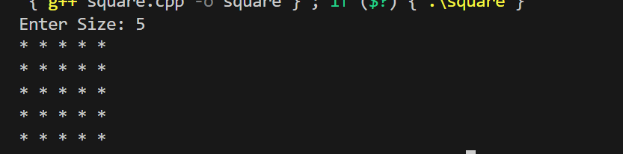
Square

Slide 4
TRIANGLES

Slide 5
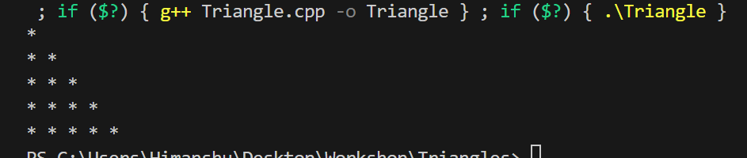
Triangle

Slide 6
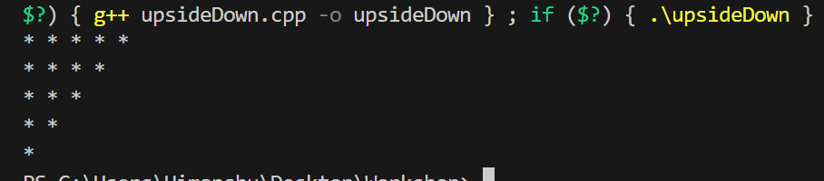
Upside Down Triangle

Slide 7

Inverted Triangle

Slide 8
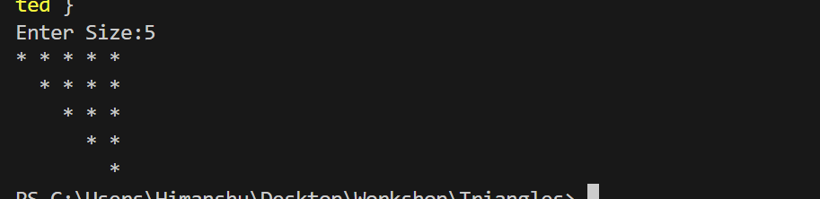
Upside down Inverted

Slide 9
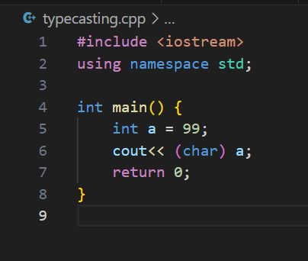
Type Casting in C++

Slide 10
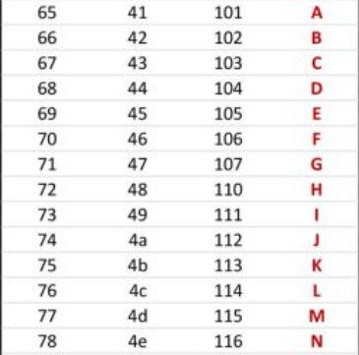
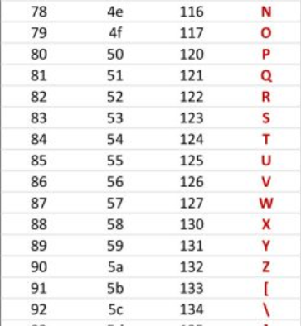
ASCII VALUES

Slide 11
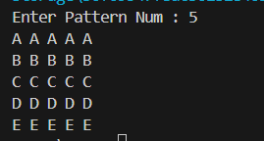
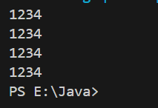
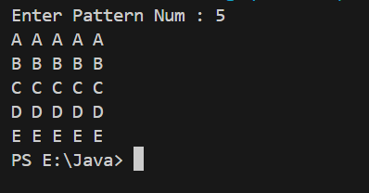

Slide 12
